Slide 2
DOMAIN NAME
DOMAIN NAME
SYSTEM

Slide 3


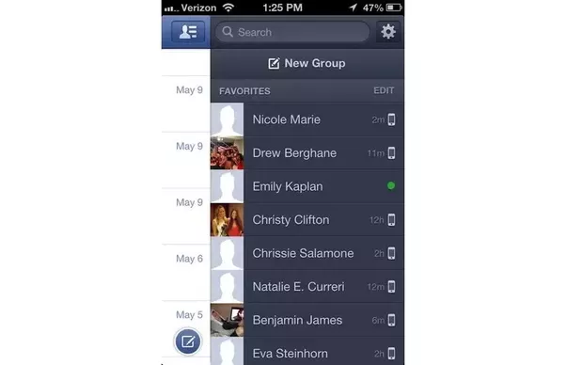

WHY??

Slide 4
What is DNS?
Domain naming system is the Hierarchical naming system for domain services, or any resource connected with internet or private network.
This system used on the internet for converting domain names to their corresponding IP address.
Capgemini
ATP
STP
DTP
F1
F2
F3
F8
T1
T2
T3
LAB PC 1

Slide 5
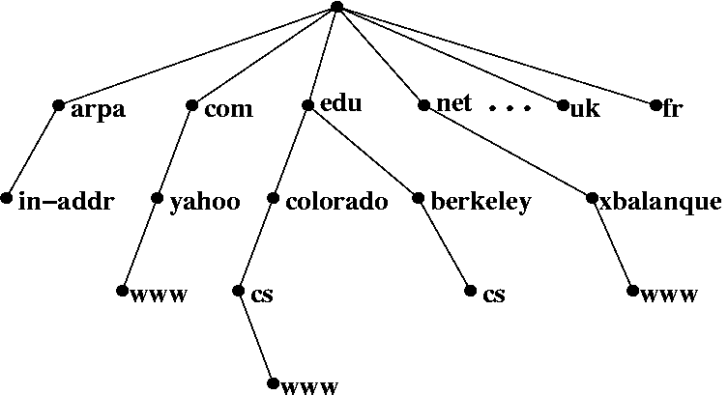
DNS HIERARCHY
Organizational
Reverse
ROOT
Geographical

Slide 6
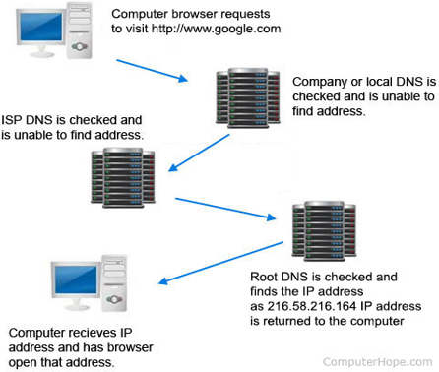
How DNS works?

Slide 7
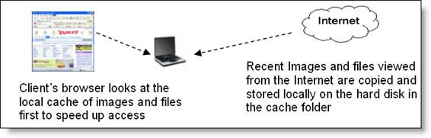
DNS Client side Caching
DNS Tools:
Whois
nslookup
DNS Records:
A record
CNAME record
SOA record
DNS Features:
Scalability
Consistency
Reliability

Slide 8

DIRECTORY SERVICES

Slide 9
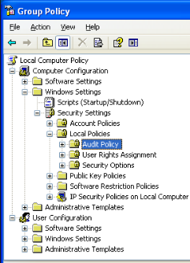
What is directory?
A Directory is a collection of information about objects arranged in some order that gives details about each object.

Slide 10
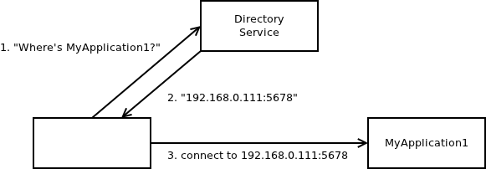
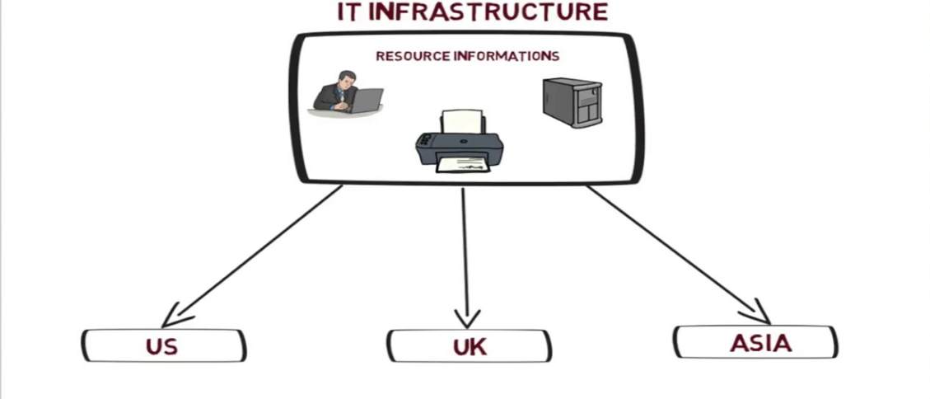
What is Directory services?
Directory services are software systems that store, organize and provide access to the directory information in order to unify network resource.

Slide 11
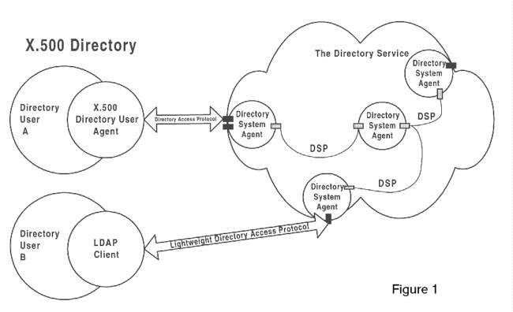
X.500 Directory
X.500 Directory Service is a standard way to develop an electronic directory of people in an organization so that it can be part of a global directory available to anyone in the world with Internet access.

Slide 12

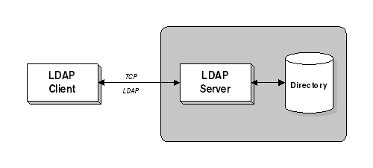
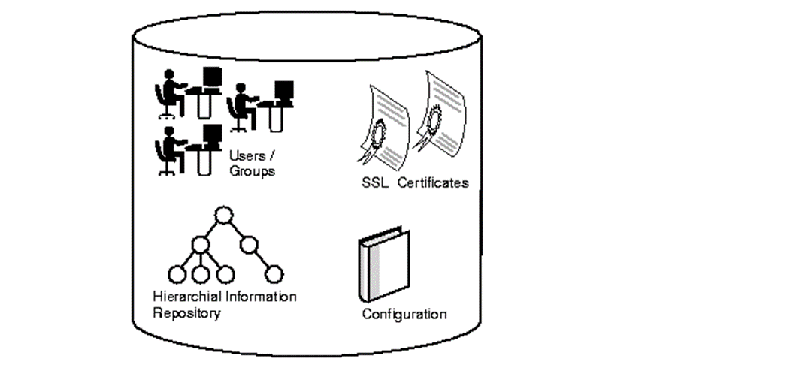
What is LDAP?
Lightweight Directory Access Protocol(LDAP) is a server or client/server protocol used to access and manage directory information.
In order to commence LDAP session, a client needs to connect to the LDAP server, which is set by default to TCP port 389 or UDP port 389

Slide 13
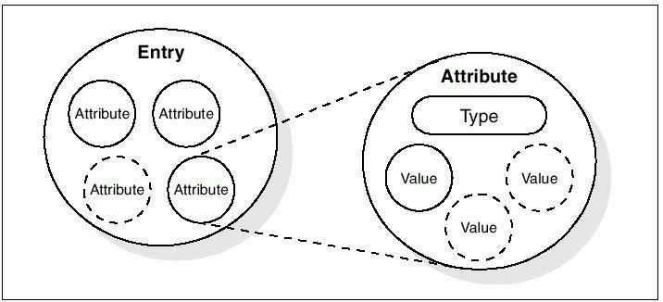
LDAP Information Storage:
Attributes hold the data for an entry.
Each attribute has an attribute type.

Slide 14
Simplifies X.500 functional modes.
Allows use of multiple directories.
Relieves burden of client.
Open source with flexible architecture
Advantages
&
Disadvantages
Updates and patches aren’t released on a regular basis.
Require additional protection such as SSL connection to LDAP server.

